Slide 1




RoMEBS RoME for the Black Sea
W. Zupa, M. T. Spedicato

Slide 2
Data quality check tool
RoME was presented for the first time in the MEDITS Coordination meeting held in Nantes (March 2011)
RoME represents a common tool to perform the data checks with a standardized procedure within MEDITS coordination.
RoMEBS 1.0, RoME for Black Sea, was presented in Burgas (May 27-30, 2019) for the “Data preparation meeting of benchmark session for Black Sea turbot”

Slide 3

Mean features
Input: Exchange data tables.csv format (TA, TB and TC, TE, TL) and additional tables from MEDITS manual (TM list, maturity scales table, Stratification, etc..)
Output: Text file (Logfile.dat) with the outcome of each check and errors/warnings specifications and graphics for qualitative controls.
Inputs
Outputs
haul____
catch ____
Sequence of the function calls in RoMEBS
Check duplicated records on TX files
Check quasi-identical records on TX files
Check AREA and YEAR fields are the same for all the files
Check dictionary on TX files
Specific checks on TA
Specific checks on TB
Specific checks on TC
Specific checks on TE
Specific checks on TL
Cross checks
biological ____
Logfile
____
species____
catches____
strata
___
RoMEBS routine detect errors, then is up to the scientists to correct them
size
___
Supplementary tables

Slide 4
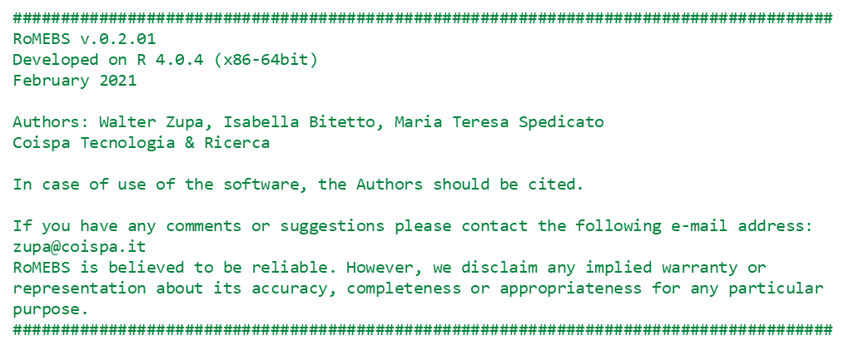

New RoMEBS version
Environment
R version > 4.0.3
Rstudio: v. 1.3.1056
Version 2.0.01
NEW FEATURES
Completely updated version, compatible with the latest version of R software
Runs on both trawl survey data (Turbot) and beam trawl survey (Rapa whelk)
More than 60 standalone check functions
Documentation embedded in the package

Slide 5

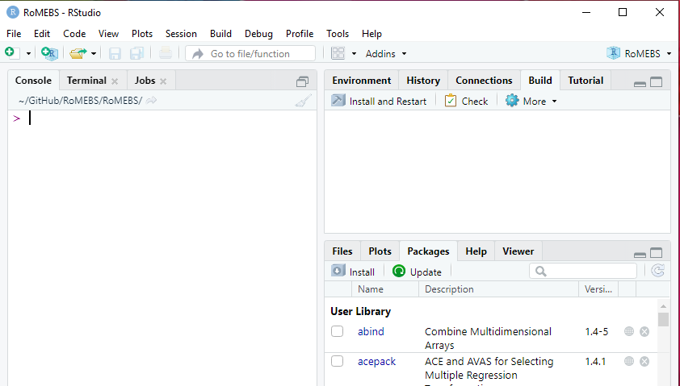
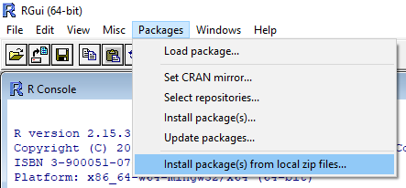
Initialization
Dependencies
svDialogs
MEDITS
timeDate
stringr
maps
sp
tcltk
RoMEBS 0.2.01 can be downloaded directly from COISPA github:
https://github.com/COISPA/R_libraries/
RoMEBS is distributed as a package to be loaded directly in R console.
RoMEBS has been produced and runs with the R version 4.0.4
Install dependencies
Install also the RoMEBS_0.2.01.zip package

Slide 6
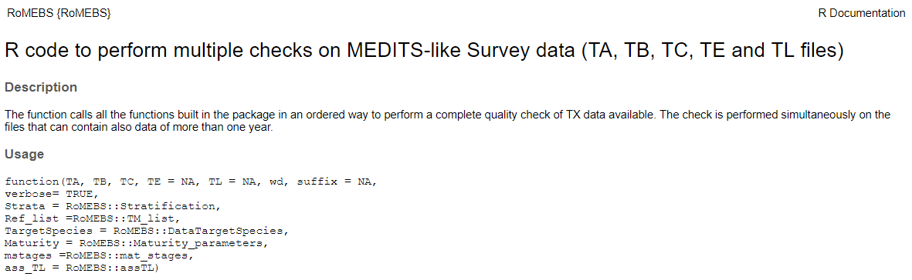
Library installation
### Install RoMEBS packages and dependencies ###
library(tools)
install.packages("https://github.com/COISPA/R_libraries/raw/main/RoMEBS_0.2.01.zip", repos=NULL)
packages <- c("svDialogs","MEDITS","timeDate","stringr","maps","sp","tcltk")
install.packages(setdiff(packages, rownames(installed.packages())))
Load RoMEBS library
Info about RoMEBS function
library(RoMEBS)
?RoMEBS

Slide 7
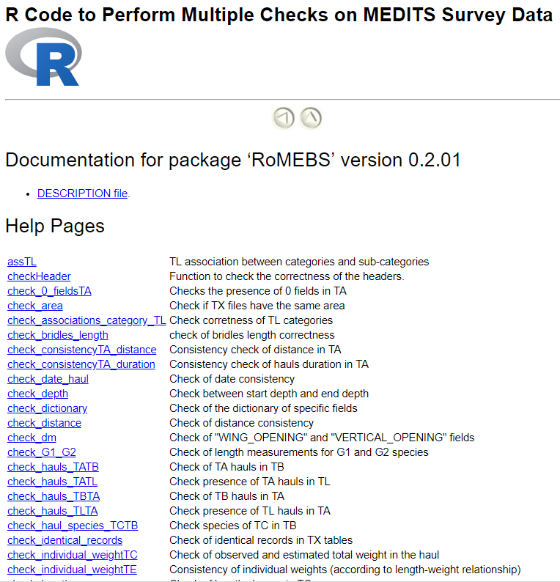
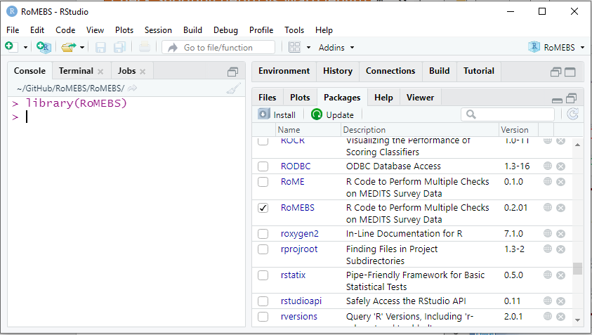
Library content
Complete documentation for each element included in the library

Slide 8
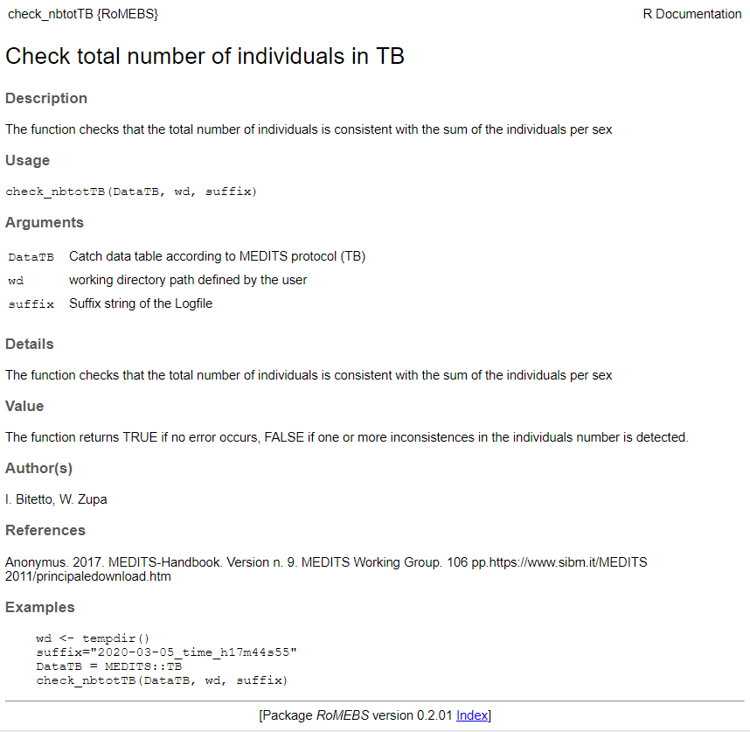
Documentation format
Briefly describe what the function does
Synopsis of the function(s) and variables documented
Details on the characteristics of the parameters to pass to the function
Provides any other important details of how the function operates
Description of the function’s return value (outputs)
provides executable R code showing how to use the function in practice

Slide 9
Launch RoMEBS function
Load RoMEBS library in R memory
library(RoMEBS)
Load TA, TB, and TC file (mandatory)
Optionally, load TE and/or TL files (
run RoMEBS function to check survey data
RoMEBS(DataTA, DataTB, DataTC, DataTE, DataTL,
wd, suffix, verbose=TRUE,
Strata=Stratification,
Ref_list=TM_list,
TargetSpecies=DataTargetSpecies,
Maturity=Maturity_parameters,
mstages=mat_stages,
ass_TL=assTL)
Demo tables already included in the R package.
Input TX tables
Output parameters
Personalized by user
Already included in the R package.
Modified tables could be used instead
Other useful tables

Slide 10
RoMEBS analysis
--------------------------------------------------------------
Disclaimer
RoMEBS v.0.2.01
Developed on R 4.0.4 (x86-64bit)
February 2021
Authors:Walter Zupa, Isabella Bitetto, Maria Teresa Spedicato
Coispa Tecnologia & Ricerca
In case of use of the software, the Authors should be cited.
If you have any comments or suggestions please contact the following e-mail address: zupa@coispa.it
RoMEBS is believed to be reliable. However, we disclaim any implied warranty or representation about its accuracy, completeness or appropriateness for any particular purpose.
--------------------------------------------------------------
[1] Check YEAR in progress...
[1] Check YEAR successfully completed!
[1] Check TYPE_OF_FILE in progress...
[1] Check TYPE_OF_FILE successfully completed!
[1] Checking year 2015
[1] Check identical record TA in progress...
[1] Check identical record TA successfully completed!
[1] Check identical record TB in progress...
[1] Check identical record TB successfully completed!
[1] Check identical record TC in progress...
[1] Check identical record TC successfully completed!
[1] Check quasi-identical record in TA in progress...
[1] Check quasi-identical record in TA successfully completed!
[1] Check quasi-identical record in TB in progress...
……
Order of the checks
CHECK HEADERS
CHECK TYPE_OF_FILE
CHECK YEAR
CHECKS by YEAR
Check identical record
Check quasi-identical record
Check consistency of area
Dictionary checks
Check no empty fields
checks on TA
checks on TB
checks on TC
checks on TE
checks on TL
Cross checks

Slide 11
GENERAL CHECK
Check quasi-identical record
Two or more "quasi-identical records" occurred when all the fields are respectively equal, except:
(these specifc fields are allowed to be identical)
Error
TYPE_OF_FILE
AREA
GEAR
VESSEL
YEAR
RIGGING
DOORS
TA table
TYPE_OF_FILE
AREA
VESSEL
YEAR
TB and TC table
Check of identical records
The function checks where there is one or more identical records in the selected type of table (TX)
Error
Check consistency of area
checks if TX files have the same area code
Error

Slide 12
GENERAL CHECK
Check of the dictionary of specific fields
The function checks whether the values contained in specific fields are consistent with the allowed values of the dictionaries.
Error
Check no empty fields
The function checks whether the values contained in specific fields are empty
Error
CHECK for TA
Check consistency between duration and time
Warning
The function checks whether the durations reported in the haul data (TA) are consistent with the differences between HAULING_TIME and SHOOTING_TIME.
Check consistency between distance and duration
Error
The function checks whether the distances reported in the haul data (TA) are consistent with the hauls duration.

Slide 13
CHECK for TA
Check difference between start depth and end depth (not greater than 20%)
Check if that difference between start depth and end depth is not greater than 20%
Warning
Check consistency of stratum code
Checks whether start depth and end depth of each haul are in the same stratum.
Warning
verifies the correctness of the stratum code, following the stratification scheme table in the MEDITS protocol.
Warning
Check position
Visual check of the haul positions
Warning
Check if the coordinates are on the Sea
Warning
Check consistency of the hauls coordinates with the distance
The function checks wherther there are inconsistencies between the DISTANCE field values and the computed distance.
Warning

Slide 14
CHECK for TB
Check correctness of species codes
Function checking the correctness of species code and faunistic category according to TM reference list
Warning
Check consistency of TOTAL number and number per sex in TB
The function checks that the total number of individuals is consistent with the sum of the individuals per sex
Error
Check consistency of weight and number TB
Function that checks if number of individuals and total weight collected in the haul are consistent. The check is quantitative if there is information related to average individual weight. Alternatively the check is qualitative (through a plot).
Warning

Slide 15
CHECK for TC
Check correctness of LENGTH_CLASSES_CODE
The function checks whether the LENGTH_CLASS_CODE by species are consistent with those reported in the TM list.
Error
Check consistency of length classes TC
The function checks whether the length classes by species are included in the range reported in the DataTargetSpecies table.
Warning
Check correctness of number per sex in TC
The function checks the consistency of the number of individuals by sex measured (NO_OF_INDIVIDUAL_OF_THE_ABOVE_SEX_MEASURED field in TC) with the sum of the individuals by sex, length class and maturity stage (NUMBER_OF_INDIVIDUALS_IN_THE_LENGTH_CLASS_AND_MATURITY_STAGE)
Error

Slide 16
CHECK for TC
Check sub-sampling
Function to warn the user about the presence of subsamples’ ratio <0.1 of the total catch
Warning
Check of observed and estimated total weight in the haul
warning is given when difference between the sum of estimated individual weights (by haul, species and sub-samples) and the WEIGHT_OF_THE_SAMPLE_MEASURED is greater than 50% for at least one record. This check is based on the LW table contained in the package.
Warning
Check consistency of length distribution TC
The function verifies that in TC the length measures are reported with the correct precision
Error
Check correctness of species codes
Function checking the correctness of species code and taxonomic category according to TM reference list
Error

Slide 17
CHECK for TE
Check correctness of species codes
Function checking the correctness of species code and taxonomic category according to TM reference list
Error
Check consistency TE check-fields
The function checks the consistency of number of individuals sampled for weight and ageing in TE
Error
Check individual weight in TE
The function checks the difference between observed and estimated individual weight in percentage.
Warning

Slide 18
cross checks
Check presence in TB of TA hauls - Check presence in TA of TB hauls
The function checks:
presence of the TA hauls in the TB
presence of the TB hauls in the TA
Error
Check presence in TC of TB target species - Check presence in TB of TC species
The function checks whether
all the species present in TC are listed in TB
all the species in the TB are in the TC
Error
Warning
Check correctness of the number per sex in TB in case of sub-sampling in TC
Function checking if, in case of sub-sampling in TC, the Total number and the number per sex in TB is raised correctly
Error
Check on date by haul
Check if in TB, TC and TE the date by haul is the same of the one reported in TA
Error

Slide 19
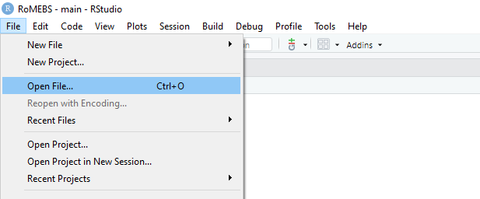
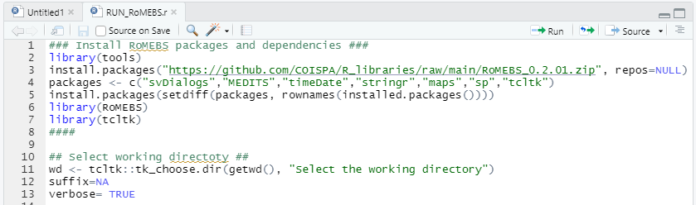
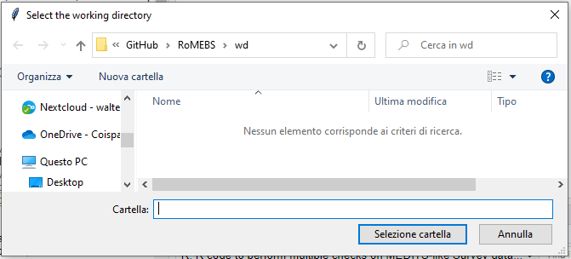
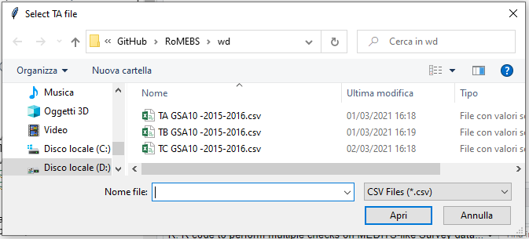
RUN_RoMEBS script
Select the file «RUN_RoMEBS.r» and load it
1
2
3
4

Slide 20
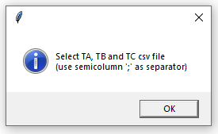
RoMEBS.wizard
Run the code and follow the the instruction
2
1
RoMEBS.wizard()
Select a suitable working directory.
3
4

Slide 21
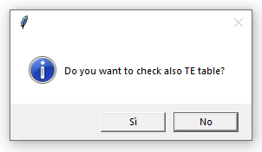
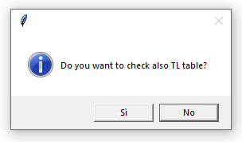
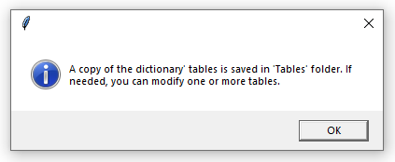
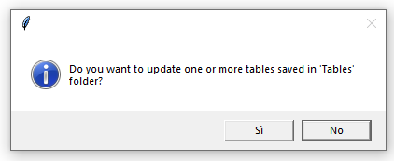
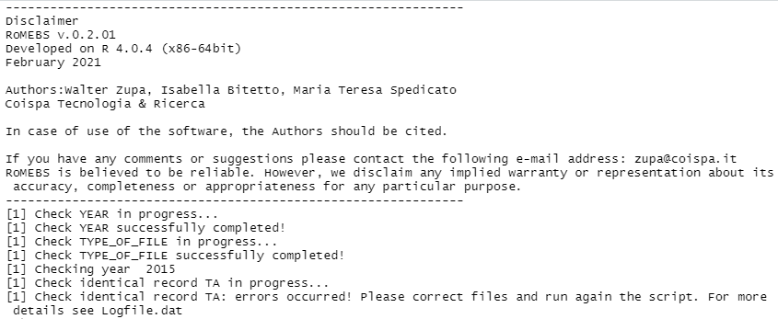
RoMEBS.wizard
5
6
7
8

Slide 22
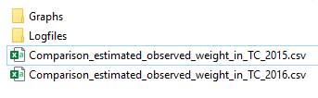
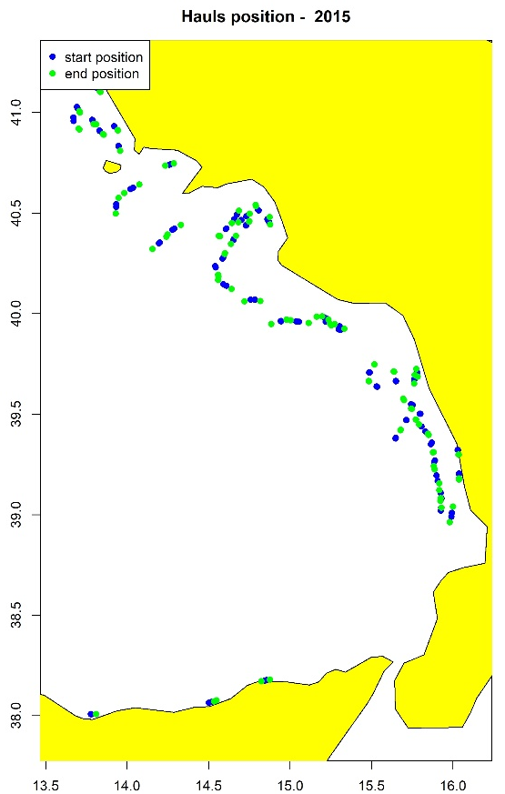
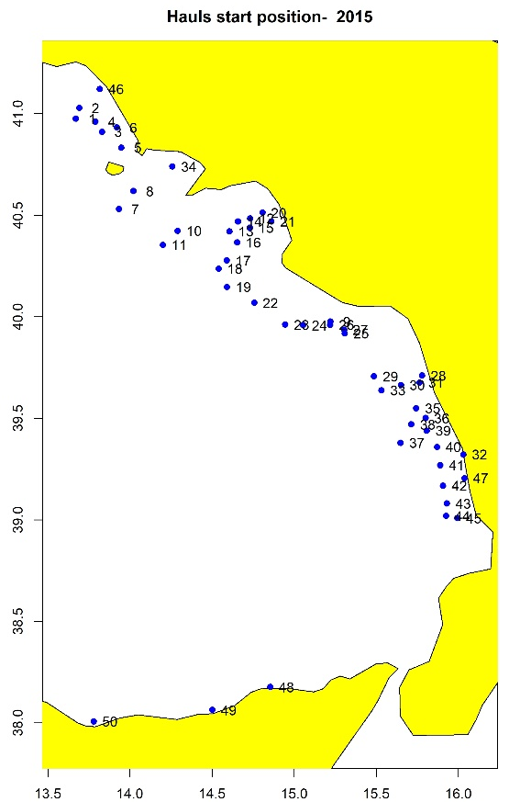
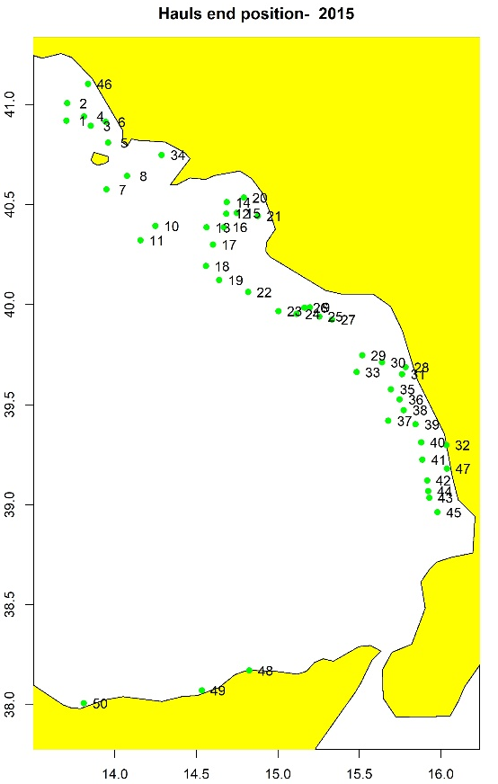
RoMEBS outputs
Logfile
Sun Feb 28 11:49:21 2021
-------------------------------------------------------------
LIST OF ERRORS
-------------------------------------------------------------
----------- check on YEAR field
No error occurred
----------- check on TYPE_OF_FILE field
No error occurred
Tables
Check mean weight
Check haul positions

Slide 23
RoMEBS outputs
qualitative checks
Check temperature
Check Shooting depth vs Warp length
Check Warp length vs Wing Opening

Slide 24

Examples of common errors
Error #1
Console
[1] Check identical record TA: errors occurred! Please correct files and run again the script. For more details see Logfile.dat
Log file
----------- check identical records - 2015
TA:
Haul 44 : identical records in TA
TA file

Slide 25
Examples of common errors
Warning #1
Log file
----------- check range of values for field: SHOOTING_DEPTH - 2015
Warning: Haul 46 : value ( 6 ) out of allowed range for SHOOTING_DEPTH in TA
No error occurred for field SHOOTING_DEPTH in TA
TA file

Slide 26
Examples of common errors
Error #2
Console
[1] Check dictionary for field: WING_OPENING: errors occurred! Please correct files and run again the script. For more details see Logfile.dat
Log file
----------- check dictionary for field: WING_OPENING - 2015
Haul 16 : value not allowed for WING_OPENING in TA
TA file

Slide 27


Examples of common errors
Error #3
Console
[1] Check consistency between duration and time TA in progress...
[1] Check consistency between duration and time TA: errors occurred! Please correct files and run again the script. For more details see Logfile.dat
Log file
----------- check consistency between duration and time TA - 2015
Haul 48 inconsistency between SHOOTING-HAULING_TIME and HAUL_DURATION in TA
TA file

Slide 28

Examples of common errors
Warning #2
WARNING MESSAGE
Log file
----------- check consistency of the hauls coordinates with the distance - 2015
Warning: Haul 34 : the distance in TA 2593 is quite different from the computed distance 91762.0058 (haul duration: 30 min)
Some of the hauls coordinates may be inconsistent with the computed distance. For a visual check, look at the .tiff files in Graphs directory
No error occurred
----------- check if the hauls positions are on sea area - 2015
Warning: Haul 34 shooting coordinates could likely fall on land
No error occurred
TA file

Slide 29
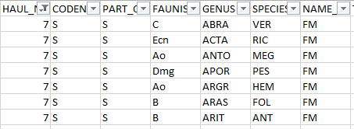
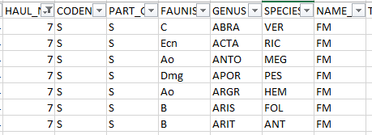
Examples of common errors
Error #4
Console
[1] Check presence in TB of TC species: errors occurred! Please correct files and run again the script. For more details see Logfile.dat
Warning #3
Log file
----------- check correctness of species codes in TB - 2015
Warning: Haul 7 : code species ARAS FOL not present in MEDITS TM list in Tables directory
No error occurred
----------- check presence in TB of TC species - 2015
Haul 7 ARIS FOL not found in TB
TB file

Slide 30

Examples of common errors
Error #5
Console
[1] Check presence in TB of TC species: errors occurred! Please correct files and run again the script. For more details see Logfile.dat
Log file
----------- check presence in TB of TC species - 2015
Haul 28 TODA SAG not found in TB
TB file

Slide 31
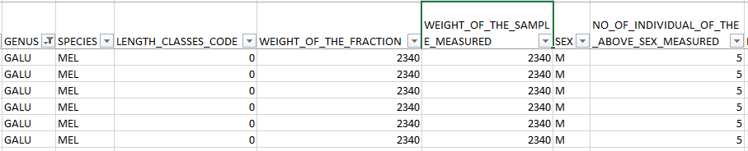
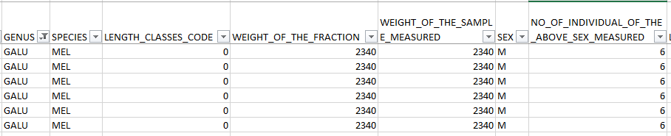
Examples of common errors
Error #6
Console
[1] Check correctness of number per sex in TC in progress...
[1] Check correctness of number per sex in TC: errors occurred! Please correct files and run again the script. For more details see Logfile.dat
Log file
----------- check consistency of number per sex in TC - 2016
Haul 23 GALU MEL M number per sex not consistent with the sum of individuals
TC file

Slide 32
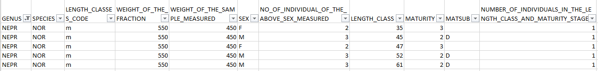
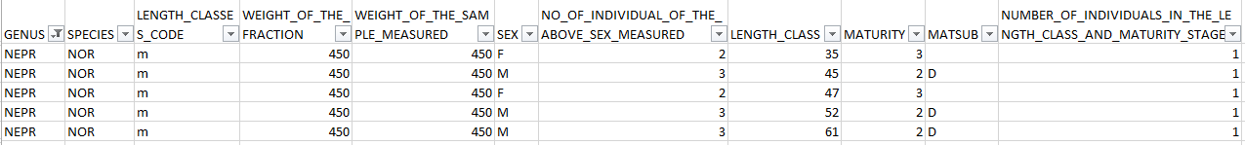
Examples of common errors
Error #7
Console
[1] Check correctness of the number per sex in TB in case of sub-sampling in TC in progress...
[1] Check correctness of the number per sex in TB in case of sub-sampling in TC : errors occurred! Please correct files and run again the script. For more details see Logfile.dat
Log file
----------- check correctness of the number per sex in TB in case of sub-sampling in TC - 2016
Haul 8 NEPR NOR NUMBER_OF_MALES in TB (3) not consistent with the sum of individuals raised per sex (4) in TC
TB file
TC file

